Slide 1
DESIGNING AND EVALUATING THE PROCESS OF SCHOOL
SELF-EVALUATIONS
Jan Vanhoof
Notes:
Good

Slide 2
Schools become better by engaging in self-evaluations
Do you agree?
You share this point of view with:
Policy makers
Inspectors
Teachers and principals
Researchers

Slide 3
Structure of this presentation
Introduction
Why engage in self-evaluation?
What is self-evaluation?
When to engage in self-evaluation?
How to design self-evaluations? Introduction of 7 guiding principles
How to use the 7 principles?
Notes:
I’ve

Slide 4
Quality care as a systematic policy making
Plan
Plan
Adjust
Adjust
Do
Do
Control/Check
Control/Check
(Bernhardt, 2004)
4

Slide 5
Components of self-evaluation in a school improvement perspective?
• Cyclical process
• On its own initiative
• Itself
• From a global quality assurance concept
• Systematic description
• Systematic assessment
• Arriving at specific improvement processes

Slide 6
Structure of this presentation
Introduction
Why engage in self-evaluation?
What is self-evaluation?
When to engage in self-evaluation?
How to design self-evaluations? Introduction of 7 guiding principles
How to use the 7 principles?

Slide 7
When? Starting with self-evaluation: (To what extent) are we ready?
Failure in your preparation is to prepare your failure
The importance of what preceeds the self-evaluation should not be underestimated

Slide 8
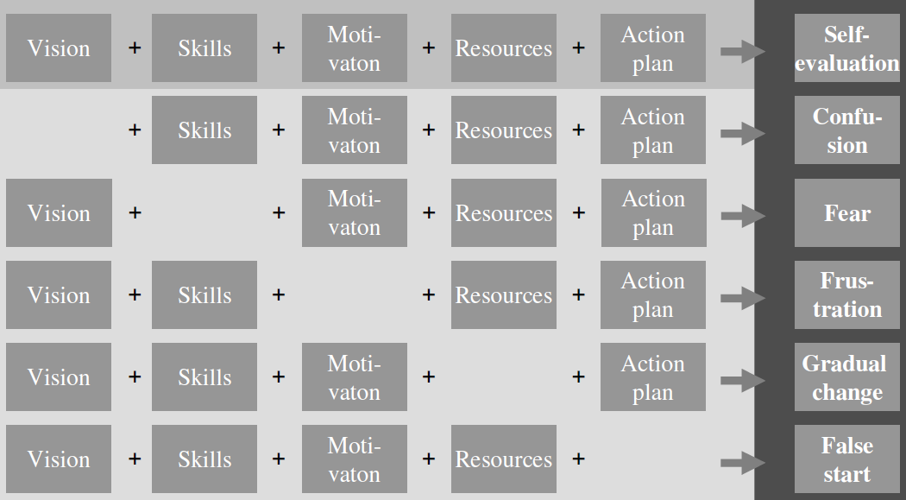
Starting with self-evaluation: (To what extent) are we ready?

Slide 9
Starting with self-evaluation: (To what extent) are we ready?

Slide 10
Attitudes towards school self evaluation: Descriptive results
Self-evaluation... | Mean | SD
...tells us nothing new/teaches us a great deal. | 4.24 | 1.29
...does not result in better teaching/results in better teaching. | 4.22 | 1.32
...takes a lot of time/takes up very little extra time. | 3.27 | 1.38
...only involves a few people/involves everybody. | 3.75 | 1.43
...does not lead to better management/leads to better management. | 4.18 | 1.40
...is difficult to interpret/is easy to understand. | 3.64 | 1.31
...is not popular with the majority of team members /is popular. | 2.75 | 1.24
...is difficult to carry out/can be carried out relatively easily. | 3.56 | 1.33
...is not cost-effective/is cost-effective. | 3.62 | 1.34
...depends on chance/results in a reliable picture. | 3.89 | 1.18
...is subjective/is objective. | 3.39 | 1.35
...is a snapshot/represents our development correctly. | 3.69 | 1.34
Scale score | 3.68 | 0.95

Slide 11
Descriptive results: Positive expectations
Self-evaluation... | Mean | SD
...tells us nothing new/teaches us a great deal. | 4.24 | 1.29
...does not result in better teaching/results in better teaching. | 4.22 | 1.32
...does not lead to better management/leads to better management. | 4.18 | 1.40

Slide 12
Descriptive results: SE is not popular in schools
Self-evaluation... | Mean | SD
...is not popular with the majority of team members /is popular. | 2.75 | 1.24

Slide 13
Descriptive results: The process of SE is scored most negatively
Self-evaluation... | Mean | SD
...takes a lot of time/takes up very little extra time. | 3.27 | 1.38
...only involves a few people/involves everybody. | 3.75 | 1.43
...is difficult to interpret/is easy to understand. | 3.64 | 1.31
...is difficult to carry out/can be carried out relatively easily. | 3.56 | 1.33
...is not cost-effective/is cost-effective. | 3.62 | 1.34

Slide 14
Starting with self-evaluation: (To what extent) are we ready?

Slide 15
Starting with self-evaluation: (To what extent) are we ready?

Slide 16
Starting with self-evaluation: (To what extent) are we ready?

Slide 17
Starting with self-evaluation: (To what extent) are we ready?

Slide 18
What is your opinion? Are we/you ready?

Slide 19
What if these conditions are not met?
First work on the deficits. But how?
Self-evaluation is both the path and the destination.
Caution should be exercised:
Start with safe topics
Small scale
Provide sufficient time and resources
"A path is made by walking on it“
Ensure the principles of self-evaluation as a policy act

Slide 20
Structure of this presentation
Introduction
Why engage in self-evaluation?
What is self-evaluation?
When to engage in self-evaluation?
How to design self-evaluations? Introduction of 7 guiding principles
How to use the 7 principles?

Slide 21
SELF-EVALUATION AS A POLICY ACTION: THE FUNDAMENTAL PRINCIPLES FOR DESIGNING AND EVALUATING SELF-EVALUATION PROCESSES

Slide 22
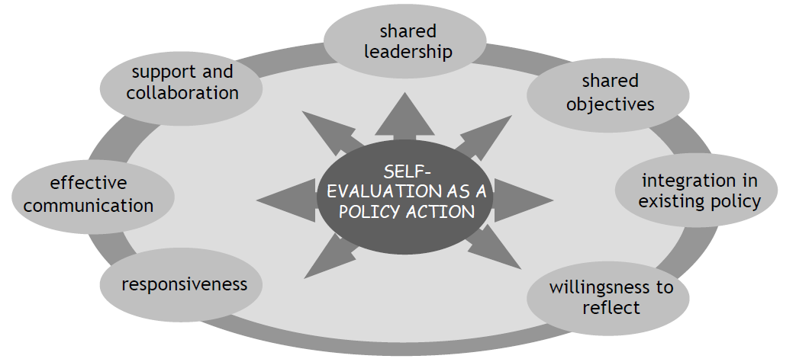

Slide 23
Some background info: Empirical basis
The 7 principles are presented by using a practical approach
All statements are based on empirical evidence:
Delphi-study with local Flemish experts
Case-studies of schools conducting self-evaluations
A survey of 2,716 respondents in 96 schools
Findings linked to other studies

Slide 24
Principle 1: The school team is prepared to engage in systematic reflection
Nobody wants to be evaluated by anybody
at anytime
House (1973)

Slide 25
Principle 1: The school team is prepared to engage in systematic reflection
Evaluations still tend to make team members feel threatened and uncomfortable
Be aware of differences within the school
Self-evaluation makes itself (im)possible
Dealing with resistance
Spray the plants, not the weed
Often source of valid criticism

Slide 26
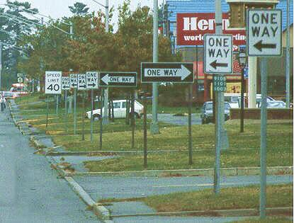
Principle 2: The school team works towards shared objectives

Slide 27
Principle 2: The school team works towards shared objectives
There needs to be clarity about what the intentions are
Come to concrete action points
Set up a conversation with the entire team
Come to legitimate policy choices
Identify good practices
Demonstrate the role team members can play in school policy
Solve concrete problems
Take the time to make the goals and expectations explicit
Effective self-evaluation thus begins with thinking about how one is going to evaluate the quality of that self-evaluation

Slide 28
Principle 3: The school team uses shared leadership as a means of creating involvement
Leadership is not a matter for the principal only
Use ‘Expertise’ and ‘commitment' to guide participation in decisions
Choose an appropriate decision-making method
Work with a steering committee
The quality of a decision | = | The intrinsic quality | x | Level of acceptance

Slide 29
Devision of responsabilities
Responsabilities/tasks | Principal | Middle mana-gement | Steeringgroup
Strategic decisions |  |  | x
Daily control | x
Advise, inspire | x |  | x
Align and integrate | x | x | x
Represent constituencies - legitimize |  |  | x
Raising awareness and communicating | x | x | x
Point of contact for team members |  | x
Practical implementation |  | x
Support | x | x | x
Monitoring the process |  |  | x
Evaluation of self-evaluation |  |  | x

Slide 30
Principle 4: The school team communicates effectively
A school principal comments:
The essence is communication. This is an attention point at the beginning, but actually all the way through. You need to allow time, in the various phases, to make sure that everyone is on board. That everyone knows what it is about and what we want to achieve. Above all, that it isn’t regarded as yet another form to fill in.

Slide 31
Principle 4: The school team communicates effectively
Take the viewpoint of team members in setting up communication
Use appropriate communication channels
Pursue an open communication climate
Put effort in the self-evaluation report

Slide 32
Principle 5: The school team seeks to create supportive relationships and collaboration.
Design the self-evaluation as a team effort
Identify your own (lacks of) knowledge and skills
Start with a stimulating timing of the self-evaluation activities
Verify whether external support is needed/appropriate

Slide 33
Principle 6: The school team integrates the self-evaluation process into existing school policy.
Anchor the self-evaluation goals into the school policy
Use a (theoretical) framework
Identify self-evaluation priorities and coordinate initiatives
Stimulate team members to adopt a broad professional approach
Work with existing groups

Slide 34
Principle 7: The school team is responsive with regard expectations concerning the self-evaluation process.

Slide 36
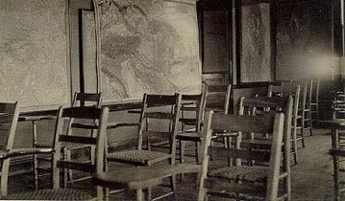
Annual meeting of the school leaders of schools with self-evaluations that perfectly fits to the principles

Slide 37
How to use these 7 principles
Designing self-evaluations
Evaluating self-evaluations
A checklist setting out a series of relevant indicators was developed for each principle

Slide 38
Example: Indicators for shared leadership during the self-evaluation
The self-evaluation procedure is not just a matter for the school management alone.
The decision-making procedures relating to the self-evaluation are transparent.
The task of carrying out the self-evaluation is not left to only one person.
Team members have the chance to get involved in the decision-making processes.
...

Slide 39
How to use these 7 principles
Indicators can be used as a basis for reflection on how well self-evaluation processes have been carried out
In a quantitative way
In a qualitative way

Slide 40
Structure of this presentation
Introduction
Why engage in self-evaluation?
What is self-evaluation?
When to engage in self-evaluation?
How to design self-evaluations? Introduction of 7 guiding principles
How to use the 7 principles?

Slide 41
Statements for discussion
Schools become better by engaging in self-evaluations
Notes:
Do we have a clear idea about what becomming better means
Do we have evaluation data

Slide 42
Statements for discussion
Nobody wants to be evaluated by anybody at anytime
House (1973)

Slide 43
Statements for discussion
The 7 principles are a useful framework for designing and evaluating the process of school self evaluations
Notes:
Reality
How to change this?

Slide 44
Questions? Thoughts? Suggestions? Advice?

