Slide 1
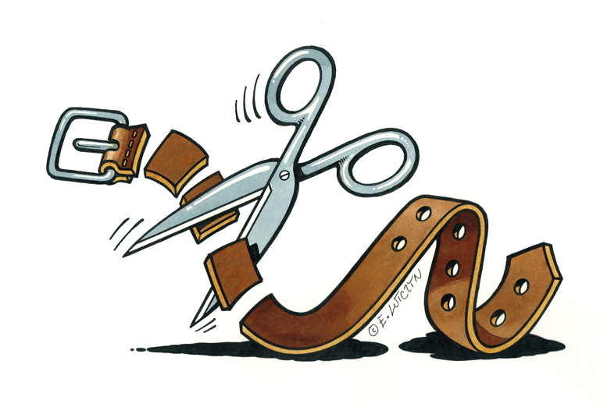
Protecting children from violence
Meaning of the prohibition of corporal punishment
Ewa Jarosz
Department of Social Pedagogy
University of Silesia

Slide 2
Social perspectives on violence against children –
evolution and co-existence
Violence against children as social norm and common practice in upbringing
Child maltreatment understood as moral, social and educational problem
Violence against children becomes an issue of a law:
Development of legislations on child protection, Convention on the rights of a child 1989, recomendations on how protect children; introducing a total ban of violence against children /full prohibition of corporal punishment /
Violence against children becomes a political issue
development of democracy, international pressure to implement child rights , children as citizens

Slide 3
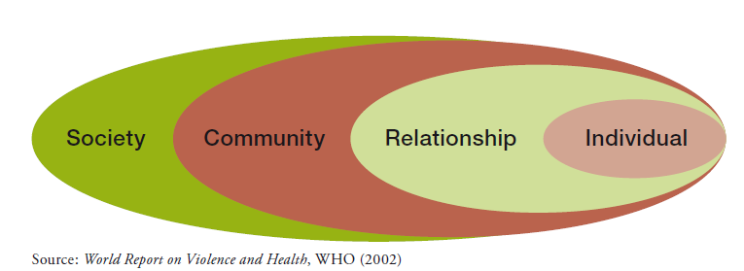
Contemporary idea of child protection from violence
Pro-active orientation
Orientation towards risk factors
P.S.Pinheiro, World report on violence against children (2006)

Slide 4
SOCIAL AND CULTURAL FACILITATORS OF VIOLENCE AGAINST CHILDREN:
negative perspective of a child : child as an object, child as a possession of parents
social acceptance of violence in upbringing, common use of corporal punishment
social acceptance of total power of parents over children
lack of social (external) control over the way of treating a child by parents

Slide 5
Main directions of the change of socio-cultural factors
Law reform; /prohibition of corporal punishment/
Development of positive parenting and family support
Social education
/social campaigns)

Slide 6
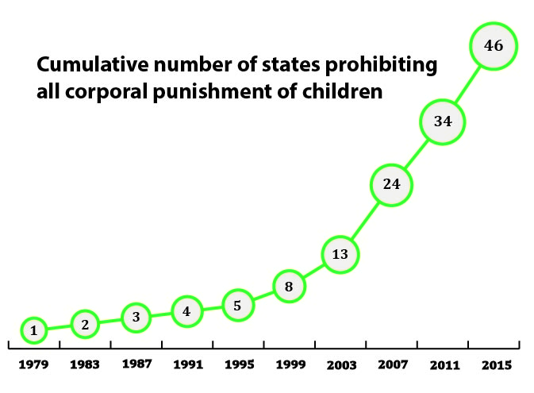
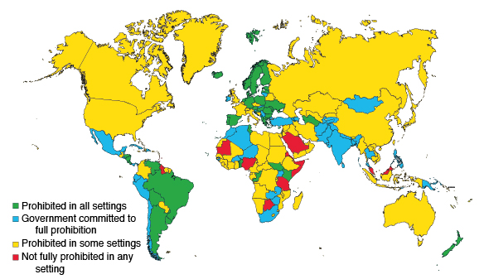
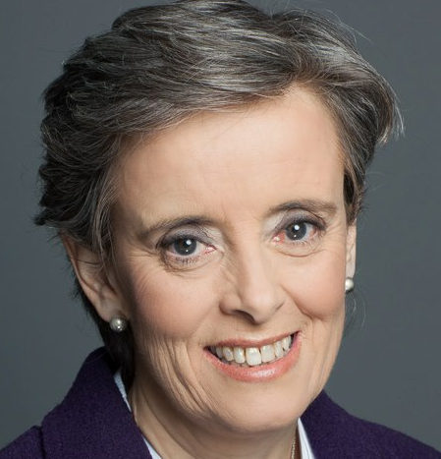
World progress to prohibition of all corporal punishment
Special Representative Secretary General UN
Marta Santos Pais
http://www.endcorporalpunishment.org/progress/countdown.html (September 2015)

Slide 7
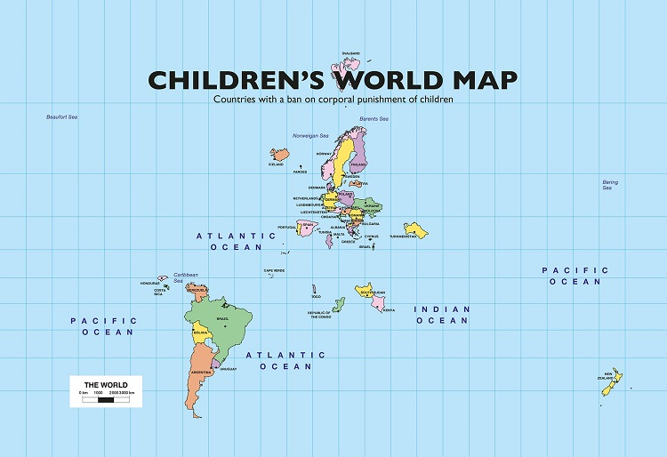
Ćeska Republika

Slide 8
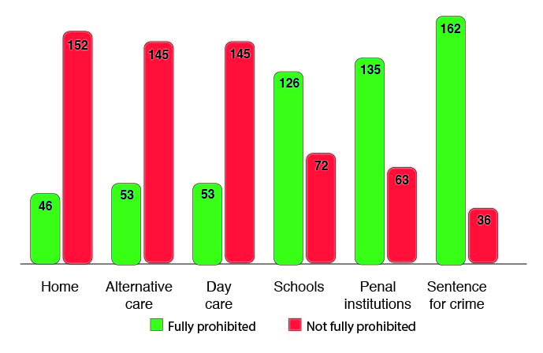
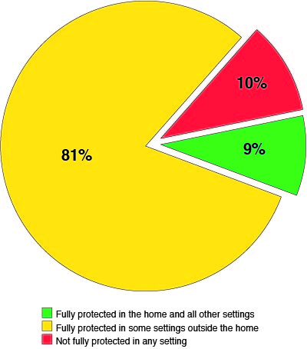
Countries with prohibition of corporal punishment
Children under total protection
Poland introduced prohibition of all corporal punishment in 2010 by the amendment to Family Code

Slide 9
Main goals:
Ombudsman on the Rights of the Child monitoring 2011-2015:
„Public attitudes towards violence in upbringing
and parents‘ use of corporal punishment”
DIAGNOSIS OF THE STATE
THE DYNAMICS
The level of social acceptance of violent behaviours against children (spanking and beating /thrashing/)
The range of treating beating as a method of upbringing and the level of general approval for corporal punishment
The scale of the violence in upbringing based on parent’s reports (since 2014)
Methodology:
random representative sample (about 1000 adults), personal interviews, the same questions

Slide 14
Parents who admitted using violent behaviours in upbringing more often are:
men
older parents (after 50)
single parents
parents of lower education
who define their financial situation as bad
who approve of spanking, thrashing and corporal punishment
finding beating an effective educational method
stating that treatment of the child remains solely the private business of the parent
those who did not think that beating children is illegal
those who experienced violence in their childchood

Slide 15
Favourable changes in POLAND in public attitudes towards violence in upbringing since introducing prohibition (2010) of corporal punishment + social campaigns
Decrease of social approval of:
beating (thrashing) by 10%
hitting (spanking) by 20%
Increase of disapproval of corporal punishment by 14%

Slide 16
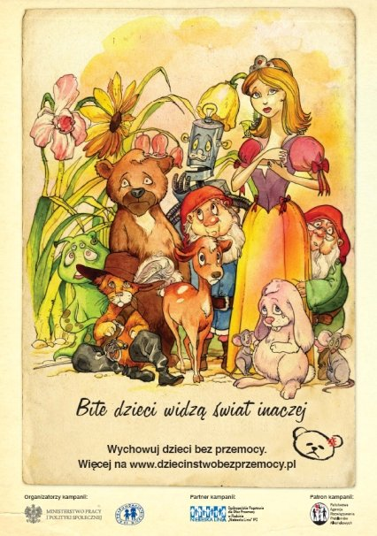
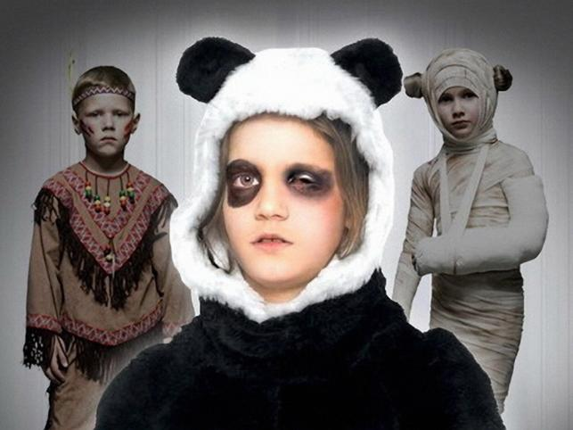

Slide 17
Ewa Jarosz University of Silesia Poland Social advisor of the Ombudsman On The Rights Of A Child
ewa.jarosz@us.edu.pl
www.niedlabicia.pl
www.brpd.gov.pl

